Slide 1
The Collectors
Team 1

Slide 2

Problem Statement

Slide 3
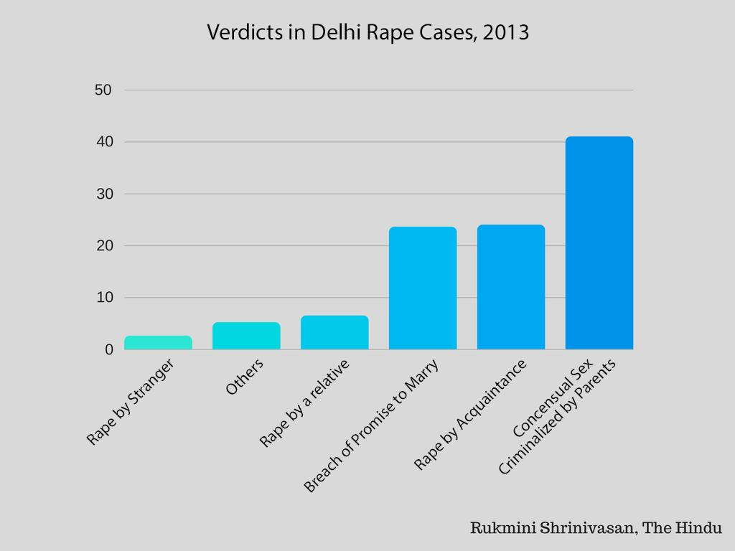
Prevent before it happens...
According to wiki, rape is the fourth most common crime against women in India. Besides that, there are many rape cases that even go unreported as the victim is unable to even realize her own self in the situation

Slide 4
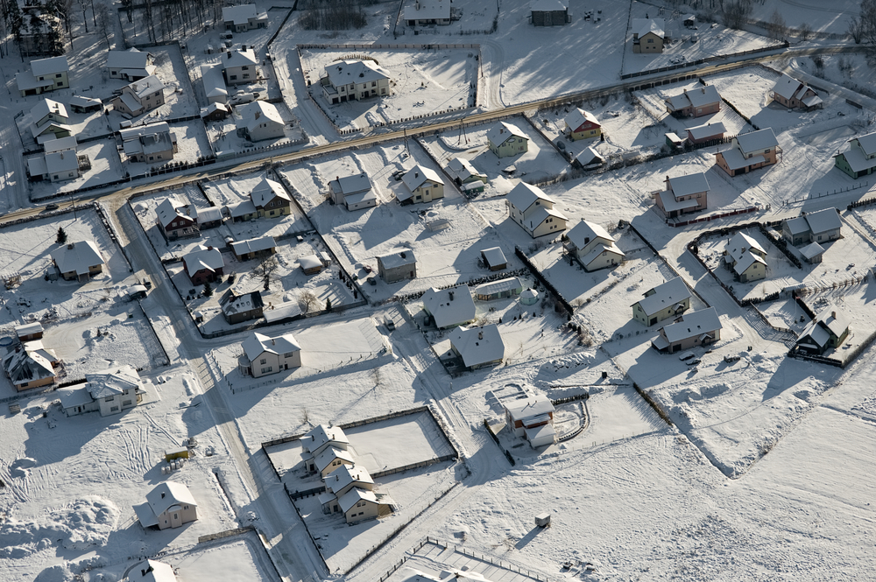
PROPOSED SOLUTIONS BY SOCIETY
To cambat rape cases and sexual harassment, our society have set certain norms, different for different kind of societies.
1
Complaints to the nearest police station
2
Safety measures like defensive arts training
3
OR DON”T GO OUT LATE NIGHT

Slide 5

WHAT??

Slide 6
Proposed Solution

Slide 7

Help
Our platform provides a solution actiong as an emergency response system for girls. Its a one button activity and your help would be at your location in the shortest way possible. Our goal is to prevent any type crime happeneing with girls around be it rape, domestic violence etc.

Slide 8


IDEA FLOW
For HELP App
RAISE A RED FLAG
2. ALERT NEARBY HELPERS
Click on the HELP button in the help irrespective of the category of the crime.
As soon as an SOS is raised, the helpers that have volunteered would receive a notification.
3. ACCEPT THE SOS
4. REPORT A USER
After you have seen a SOS in your proximity, click on ACCEPT button to inform the victim.
A helper may even report a user if found false positive.

Slide 9
FEATURES
01
02
For HELP App
Fastest safety for women
Easy to use
FEATURES
03
04
Automated alerts with real time location detection.
Ability to report false positives.

Slide 10
So don’t worry…..
coz we are here for you

Slide 11
THANK YOU

